Slide 1
IOT(Unit-10) BUILD AND TEST AUTOMATION

Slide 2
Control in build and test automation.
The main practice in a CI pipeline is to automate the build process. Within a build process, you want to ensure you are integrating and performing unit tests so that builds fail for code that does not meet functional requirements.

Slide 3
Cvcd pipeline incorporates automated development and testing.
CVCD: (Committee of Vice-Chancellors and Directors)

Slide 4
Develop an integrated development environment for different types of products.
An integrated development environment (IDE) is a software application that provides comprehensive facilities for software development. An IDE normally consists of at least a source-code editor, build automation tools, and a debugger. Some IDEs, such as IntelliJ IDEA, Eclipse and Lazarus contain the necessary compiler, interpreter or both; others, such as SharpDevelop and NetBeans, do not.

Slide 5

Apply different approaches to integrade different build and tos automation tools.

Slide 6
develop a staging environment for production
A staging environment (stage) is a nearly exact replica of a production environment for software testing. Staging environments are used to test codes, builds and updates to ensure quality under a production-like environment before application deployment.

Slide 7
Use different tools for test automation such as selenium.
Integration with other tools: Selenium can be integrated with other testing tools, such as JUnit and TestNG, making it a flexible and comprehensive solution for automating web applications.

Slide 8
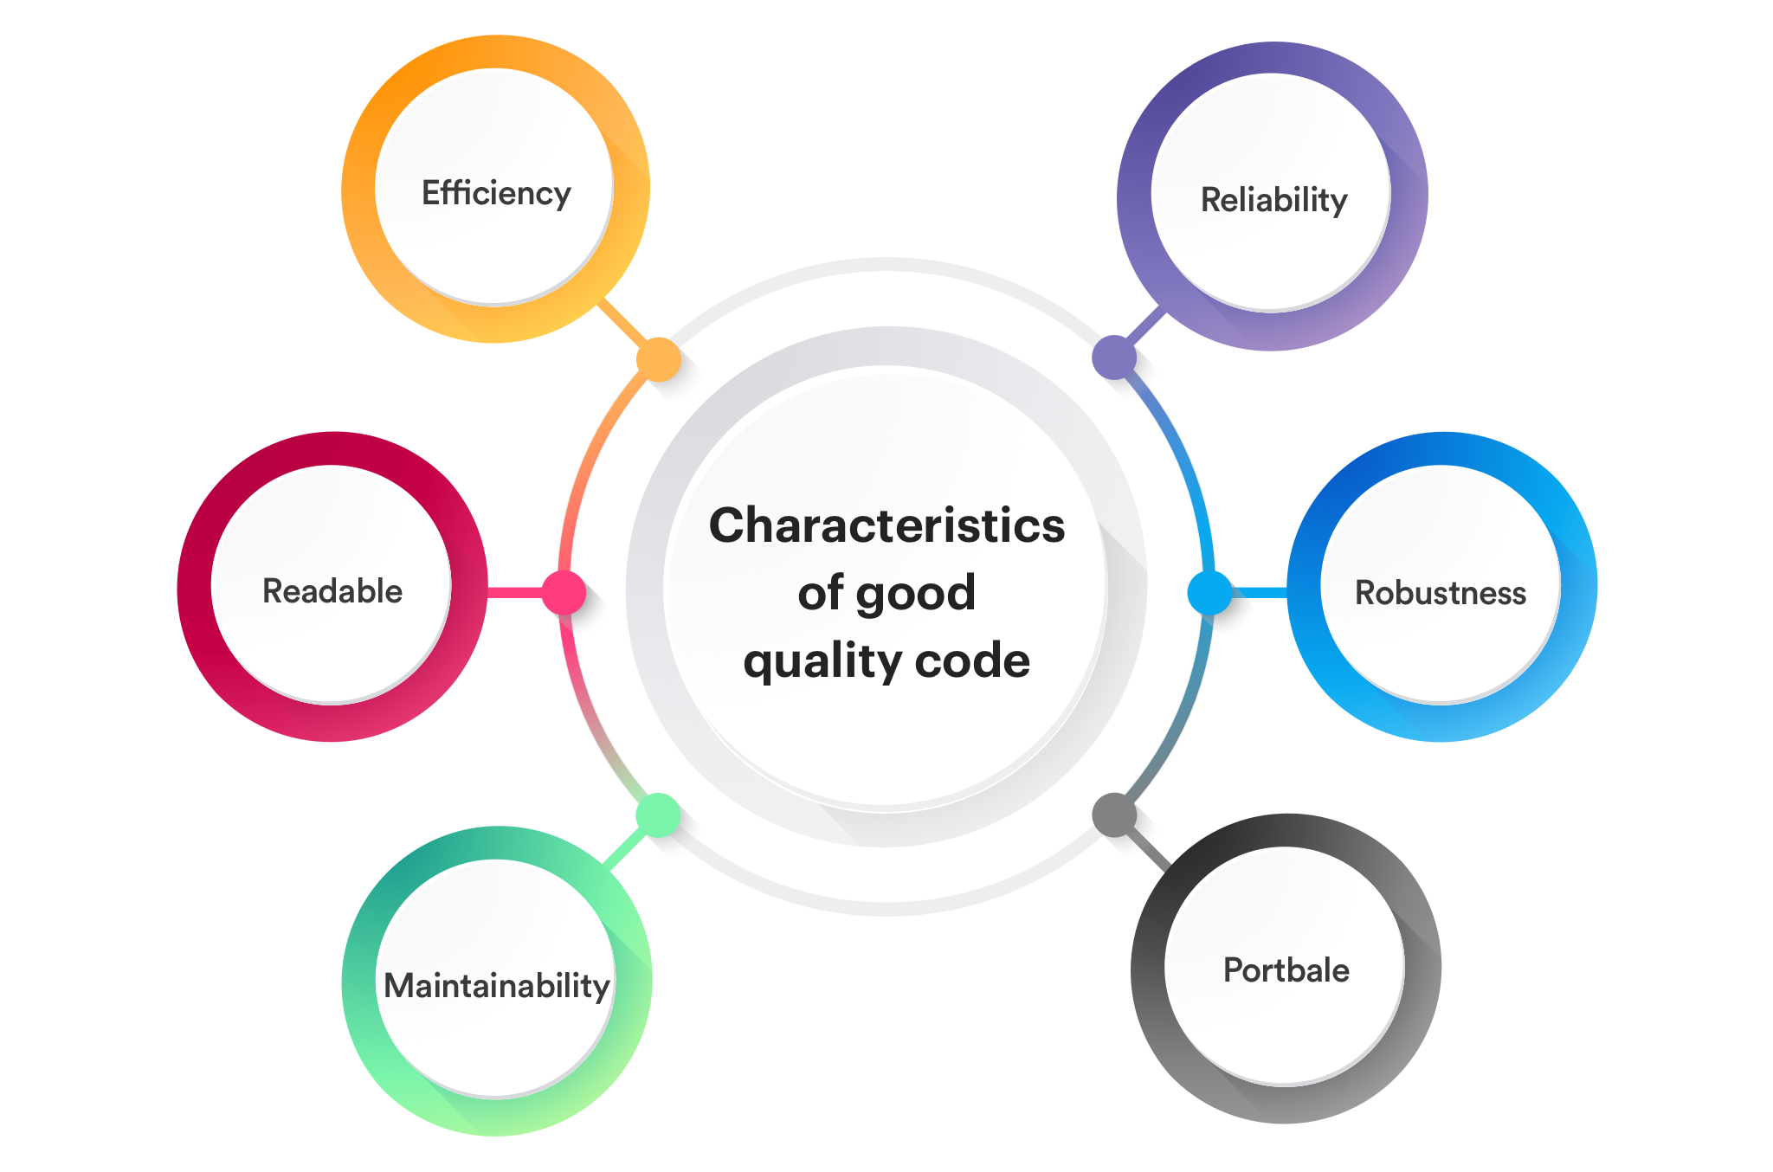
Quality of the source code.

Slide 9
Apply different code quality principles
10 Good Coding Principles to improve code quality
01 Follow Code Specifications. ...
02 Documentation and Comments. ...
03 Robustness. ...
04 Follow the SOLID principle. ...
05 Make Testing Easy. ...
06 Abstraction. ...
07 Utilize Design Patterns, but don't over-design. ...
08 Reduce Global Dependencies.

Slide 10
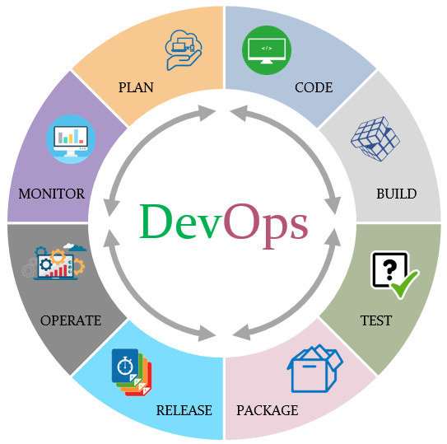
different tools for application release automation.

Slide 11
Assess the quality of the the source code.
Some other properties of code that contribute to high quality code are code clarity, complexity, safety, security, maintainability, testability, portability, reusability, and robustness.

Slide 12
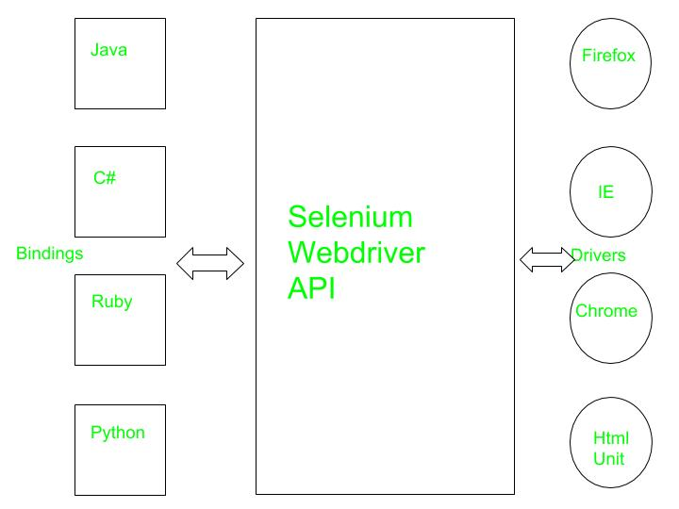
Test automation such as selenium

Slide 13

By
Ramya

